Slide 1



Slide 2
What is CommerceBlock?
= Commerce on the Blockchain
CommerceBlock allows users to trade financial instruments on the blockchain using smart contracts on a transparent, secure platform that is enforced by the faith and trust of the bitcoin community.
Commerceblock - September 2016

Slide 3






Problem & Solution
To buy a sugar commodity now, you must go through a registered FCM which is usually an investment bank which then sends an order to the exchange which which then requires you to post margin and clear before the trade is executed, thereby incurring countless commission costs, time and most importantly, room for error.
Futures Commission Merchant
Or “investment bank”
Trader
Exchange
Sugar producer in South Africa
With CommerceBlock, trade details are captured in a smart contract which is immediately posted on the block chain thereby saving you time & commission costs.
Trader
Sugar producer in South Africa
Commerceblock - September 2016

Slide 4
Process
CommerceBlock establishes a trustless setup with its customers by utilizing Bitcoin’s multisig capabilities
Customers use CommerceBlock to author their Smart Contracts
CommerceBlock never stores user funds
Contracts are stored locally by the customers
CommerceBlock provides workflow management for the duration of the contract
Commerceblock - September 2016

Slide 5

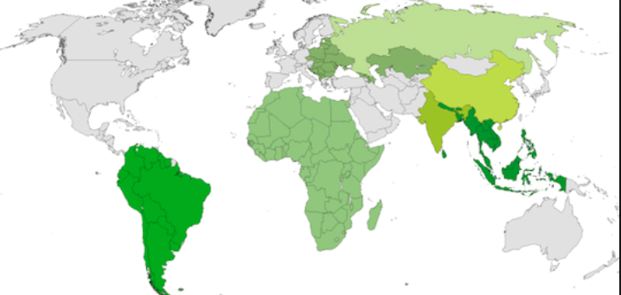
Market Scope
Without the presence of a liquid and global banking system, frontier markets present the biggest market opportunity for CommerceBlock.
Commodities Market Opportunity (Annual): $490,000,000
Total West African Market Size (Annual): $1,250,400,000
With CommerceBlock, I can seamlessly and securely trade with anyone, anywhere in the world with an internet connection.
Commerceblock - September 2016

Slide 6
Current State
1st market opportunity identified – Sugar trading into West Africa (WAF)
Partnered with Bitcoin Exchange in Ghana
Brazalian sugar refinery oboard for first trade
West African government backed syndicates eager to start trading
Identified key technical personnel despite scarcity of resources
Close to completion of prototype
Commerceblock - September 2016

Slide 7

Who are we?
Nicholas Gregory (CommerceBlock founder) is a software architect and big data expert and bitcoin aficionado. He spent the first 15 years of his career in a top global investment bank in derivatives-linked trading technology and 5 years in software development and has worked in London, New York and Hong Kong covering emerging and developed markets.
He regularly speaks at fintech disruption seminars in New York City and advises top hedge funds on crypto currency trading. In his spare time, Nicholas teaches martial arts and mentors young tech entrepreneurs.
Team also includes developers from the Buenos Ares Bitcoin center in Argentina and emerging markets commodities traders.
Commerceblock - September 2016

